Slide 1
Accelerometer + Wi-Fi
Candace Caimol
Email: caimol@unlv.nevada.edu

Slide 2
AIM & ACCOMPLISHMENT
AIM 1. Have Atmega328P microcontroller obtain readings from MPU6050 Accelerometer via I2C interface. 2. Connect to ESP8266 Wi-Fi module (flashed with AT firmware) and upload data onto cloud service (Thingspeak.com). Module will be connected to PC via FTDI 232R and will be programmed using ESPlorer application. 3. Data will consist of x, y, and z coordinates and will be updated every 500ms. They will be plotted as points on a line graph on Thingspeak.
ACCOMPLISHMENT 1. Got the Atmega328P microcontroller to read from MPU6050 via I2C. Can display numerical values on terminal window (Putty) via UART (using 5V FTDI) 2. Flashed the AT firmware onto ESP8266. Using ESPlorer, was able to connect to network using mobile hotspot and was able to directly write values to graph on ESPlorer 3.Able to read values from MPU6050 and write the values onto graphs on Thingspeak

Slide 3
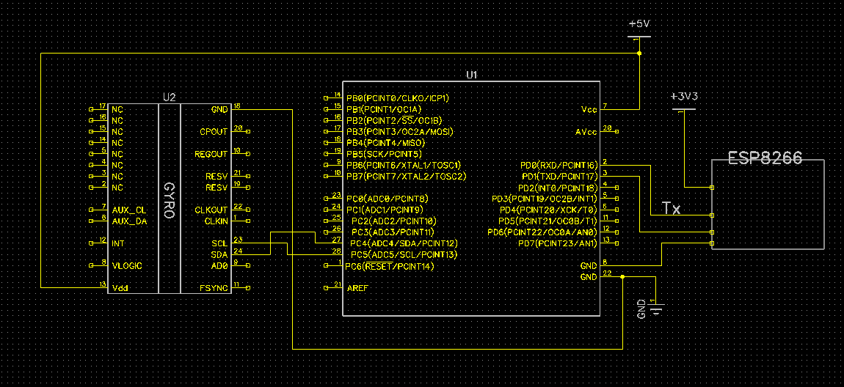
SCHEMATICS

Slide 4
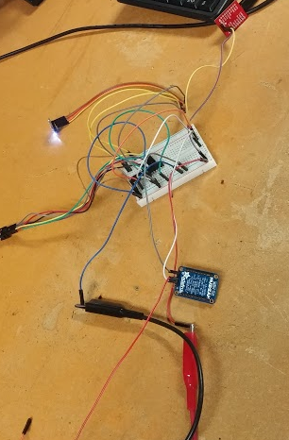
DESIGN STAGES
Components 1. AVR ATMEGA328P 2. MPU 6050 3. ESP 8266 4. FT232R Breakout
Interfaces 1. Atmega328P – MPU6050 using I2C- Address 0xD0
IOT 1. Mobile Hotspot 2. Thingspeak server

Slide 5
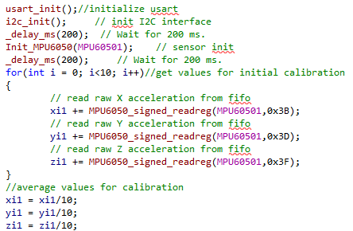
CODE DEVELOPMENT
Initialization
ESP8266 had to be flashed with AT firmware
USART initialized
I2C initialized
MPU6050 initialized
Calculated initial calibration

Slide 6
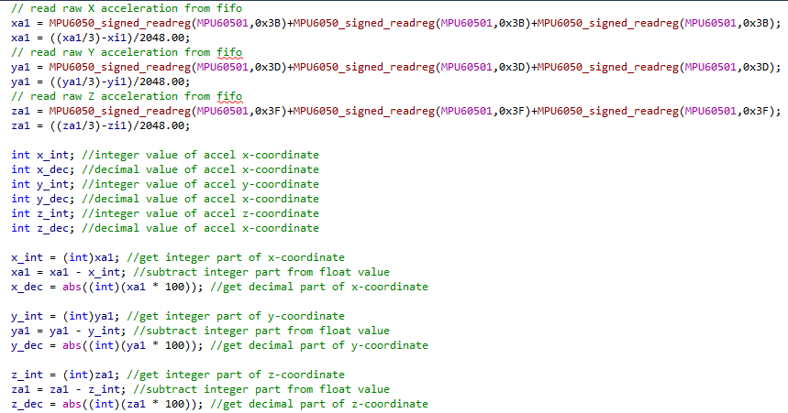
CODE DEVELOPMENT
Data Collection
Get raw value in relation to initial calibration value
Convert whole number and decimal part of float into displayable int values

Slide 7
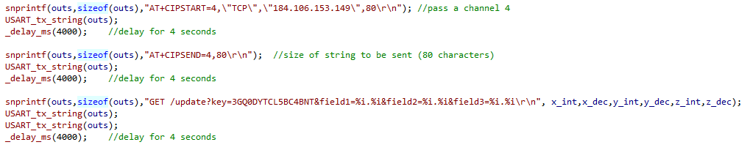
CODE DEVELOPMENT
IOT/Visualization
Commands sent to Wi-Fi module to plot measured values
Sent to Thingspeak using mobile hotspot as network

Slide 8
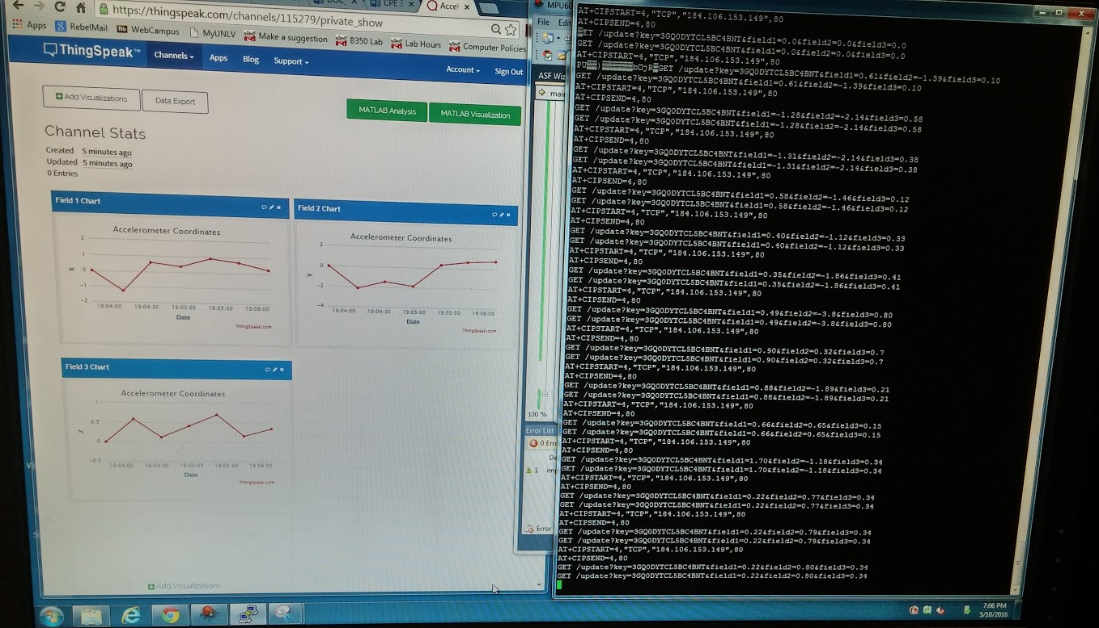

Slide 9
DEMO SNAPSHOT/VIDEO
YouTube Link:
https://www.youtube.com/watch?v=WJ31DFZCghI

